Slide 1
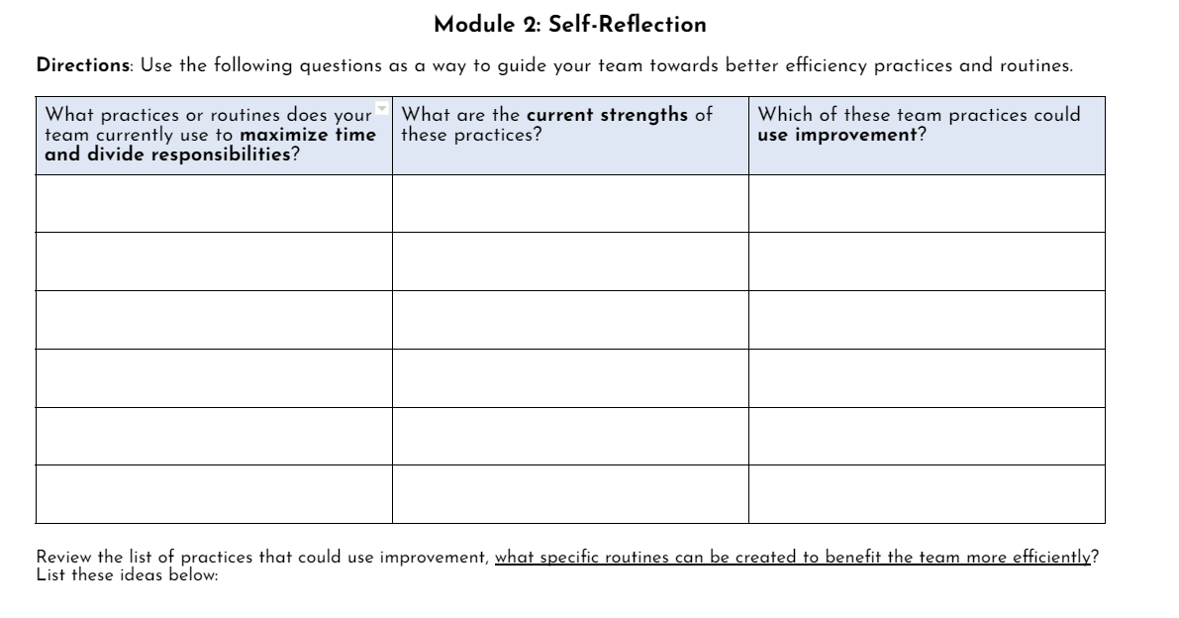
Participants apply efficiency practices with this organizer

Slide 2
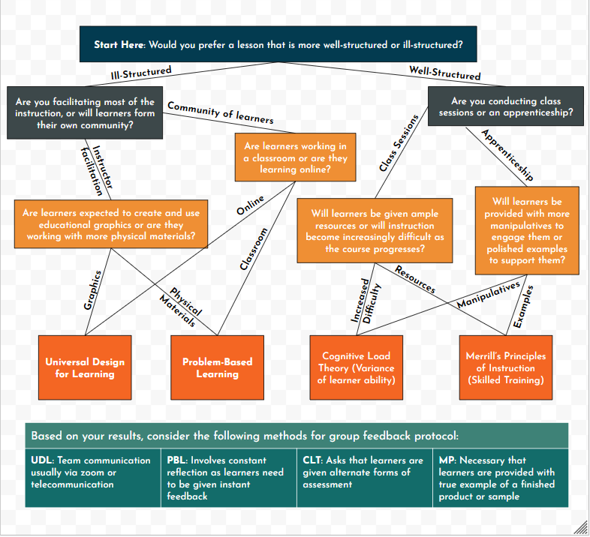
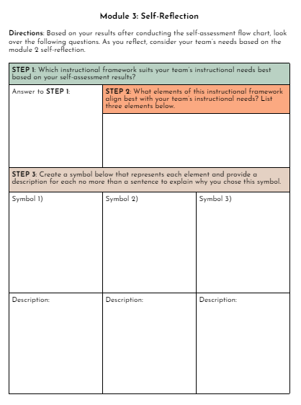
Participants will assess themselves, then complete a self-reflection to analyze their results

Slide 3
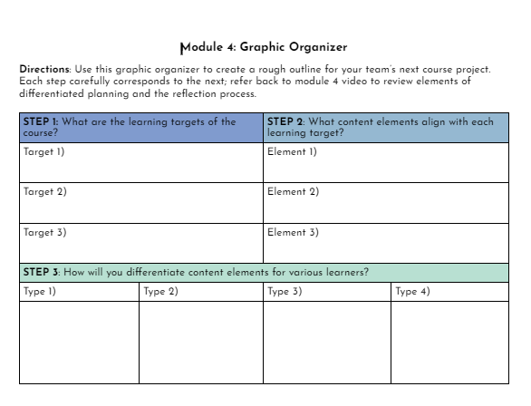
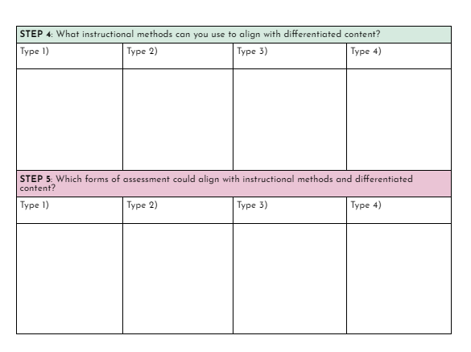
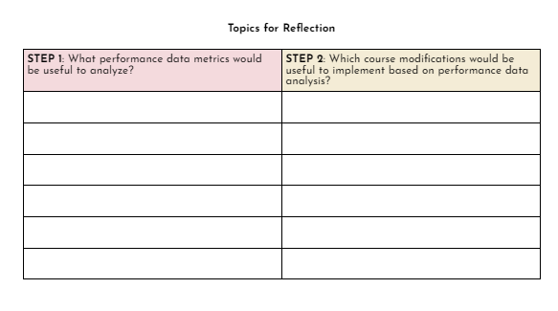
PAGE 2
PAGE 1
PAGE 3
Participants will complete this graphic organizer to create a differentiated planning method:

Slide 4
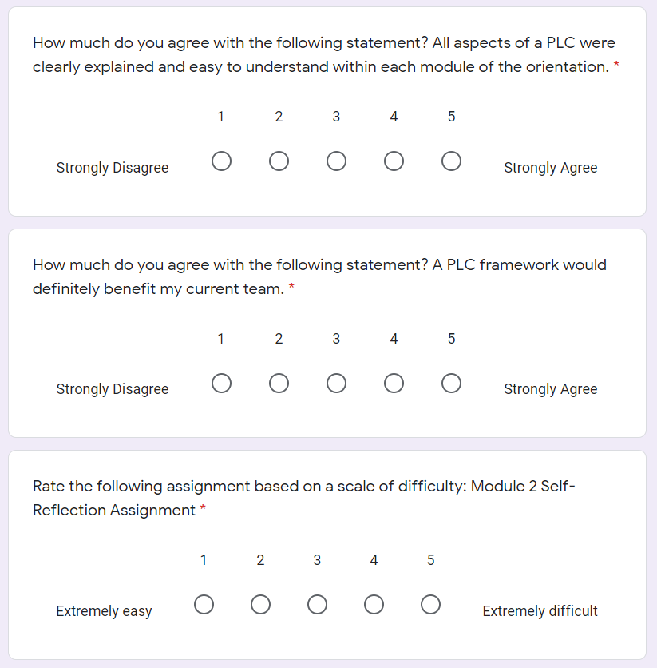
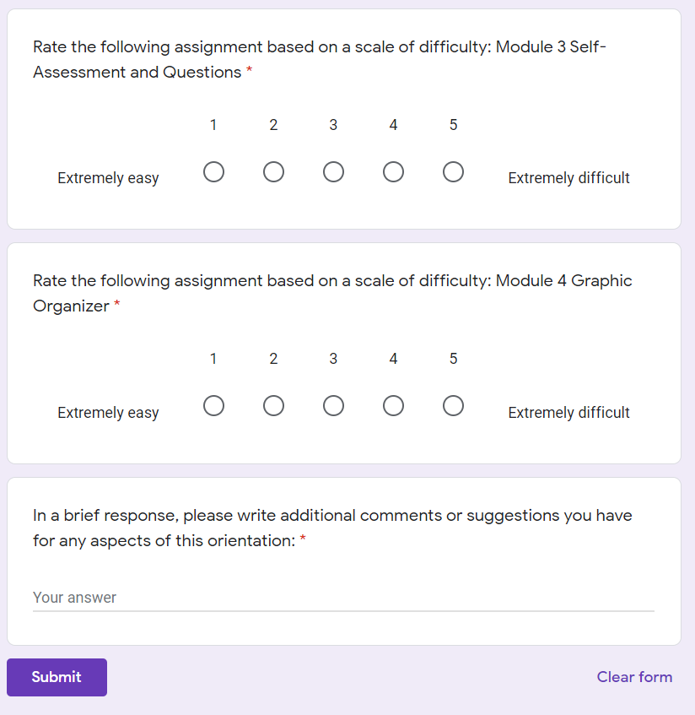
PART 1
PART 2
Participants will complete this survey after completing the course to provide suggested feedback:

